Slide 1
Processes and Threads
Chapter 2
Tanenbaum & Bo,Modern Operating Systems:4th ed., (c) 2013 Prentice-Hall, Inc. All rights reserved.

Slide 2
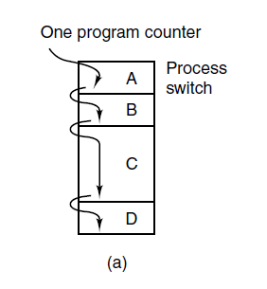
The Process Model (1)
Figure 2-1. (a) Multiprogramming of four programs.
Tanenbaum & Bo,Modern Operating Systems:4th ed., (c) 2013 Prentice-Hall, Inc. All rights reserved.

Slide 3
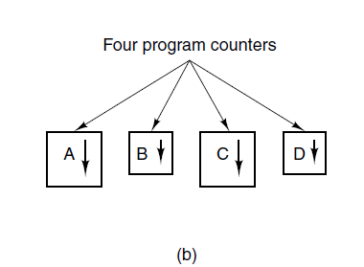
The Process Model (2)
Figure 2-1. (b) Conceptual model of
four independent, sequential processes.
Tanenbaum & Bo,Modern Operating Systems:4th ed., (c) 2013 Prentice-Hall, Inc. All rights reserved.

Slide 4
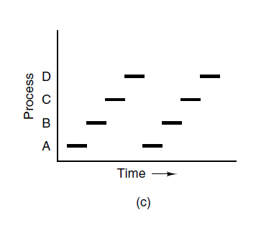
The Process Model (3)
Figure 2-1. (c) Only one program is active at once.
Tanenbaum & Bo,Modern Operating Systems:4th ed., (c) 2013 Prentice-Hall, Inc. All rights reserved.

Slide 5
Process Creation
Four principal events that cause processes to be created:
System initialization.
Execution of a process creation system call by a running process.
A user request to create a new process.
Initiation of a batch job.
Tanenbaum & Bo,Modern Operating Systems:4th ed., (c) 2013 Prentice-Hall, Inc. All rights reserved.

Slide 6
Process Termination
Typical conditions which terminate a process:
Normal exit (voluntary).
Error exit (voluntary).
Fatal error (involuntary).
Killed by another process (involuntary).
Tanenbaum & Bo,Modern Operating Systems:4th ed., (c) 2013 Prentice-Hall, Inc. All rights reserved.

Slide 7
Process States (1)
Three states a process may be in:
Running (actually using the CPU at that instant).
Ready (runnable; temporarily stopped to let another process run).
Blocked (unable to run until some external event happens).
Tanenbaum & Bo,Modern Operating Systems:4th ed., (c) 2013 Prentice-Hall, Inc. All rights reserved.

Slide 8
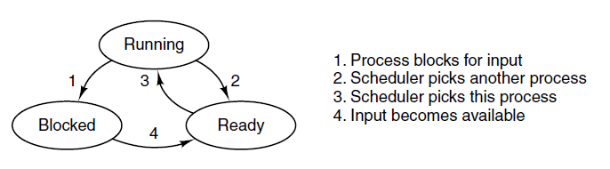
Process States (2)
Figure 2-2. A process can be in running, blocked, or ready state. Transitions between these states are as shown.
Tanenbaum & Bo,Modern Operating Systems:4th ed., (c) 2013 Prentice-Hall, Inc. All rights reserved.

Slide 9
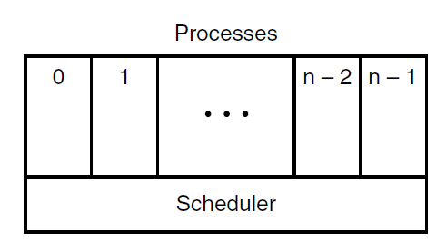
Process States (3)
Figure 2-3. The lowest layer of a process-structured operating system handles interrupts and scheduling. Above that layer are sequential processes.
Tanenbaum & Bo,Modern Operating Systems:4th ed., (c) 2013 Prentice-Hall, Inc. All rights reserved.

Slide 10
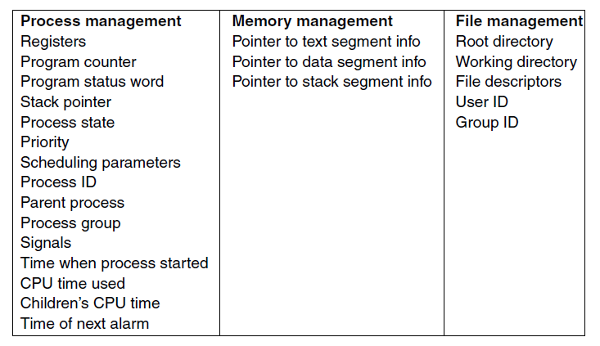
Implementation of Processes (1)
Figure 2-4. Some of the fields of a typical process table entry.
Tanenbaum & Bo,Modern Operating Systems:4th ed., (c) 2013 Prentice-Hall, Inc. All rights reserved.

Slide 11
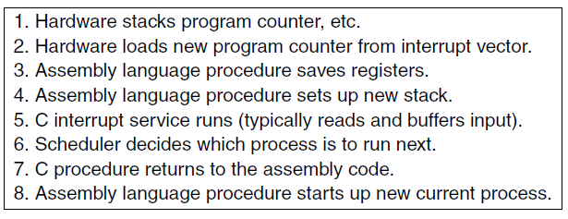
Implementation of Processes (2)
Figure 2-5. Skeleton of what the lowest level of the operating system does when an interrupt occurs.
Tanenbaum & Bo,Modern Operating Systems:4th ed., (c) 2013 Prentice-Hall, Inc. All rights reserved.

Slide 12
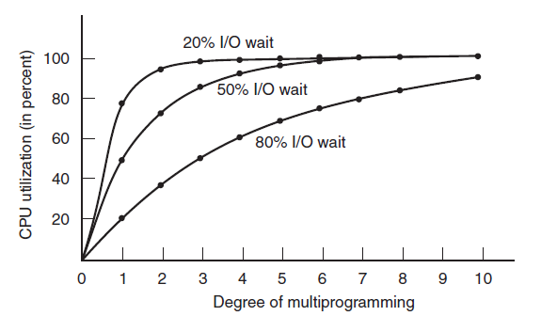

Modeling Multiprogramming
Figure 2-6. CPU utilization as a function of the number of processes in memory.
Tanenbaum & Bo,Modern Operating Systems:4th ed., (c) 2013 Prentice-Hall, Inc. All rights reserved.

Slide 13
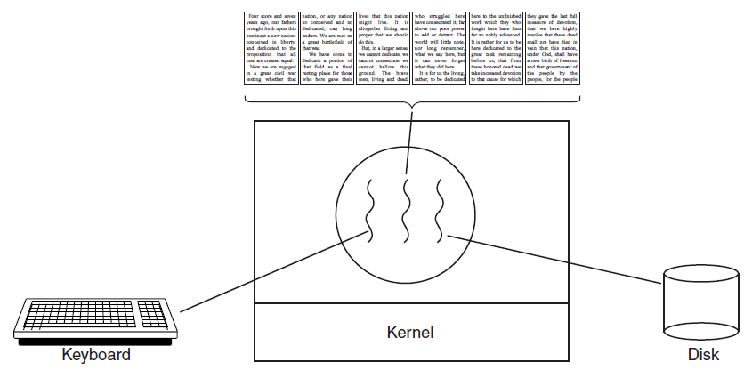
Thread Usage (1)
Figure 2-7. A word processor with three threads.
Tanenbaum & Bo,Modern Operating Systems:4th ed., (c) 2013 Prentice-Hall, Inc. All rights reserved.

Slide 14
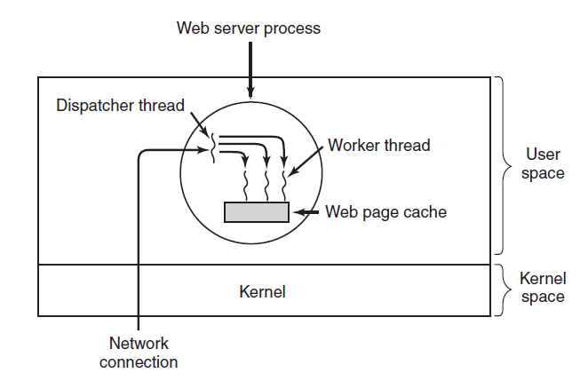
Thread Usage (2)
Figure 2-8. A multithreaded Web server.
Tanenbaum & Bo,Modern Operating Systems:4th ed., (c) 2013 Prentice-Hall, Inc. All rights reserved.

Slide 15
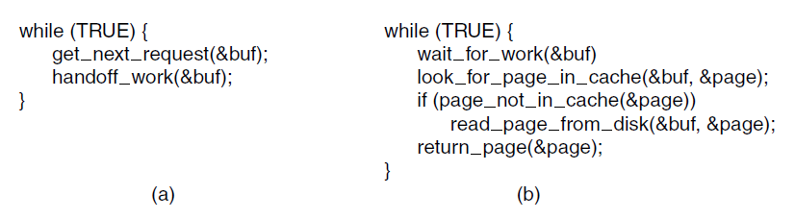
Thread Usage (3)
Figure 2-9. A rough outline of the code for Fig. 2-8.
(a) Dispatcher thread. (b) Worker thread.
Tanenbaum & Bo,Modern Operating Systems:4th ed., (c) 2013 Prentice-Hall, Inc. All rights reserved.

Slide 16
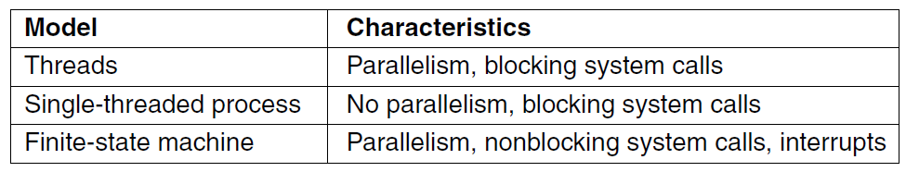
Thread Usage (4)
Figure 2-10. Three ways to construct a server.
Tanenbaum & Bo,Modern Operating Systems:4th ed., (c) 2013 Prentice-Hall, Inc. All rights reserved.

Slide 17
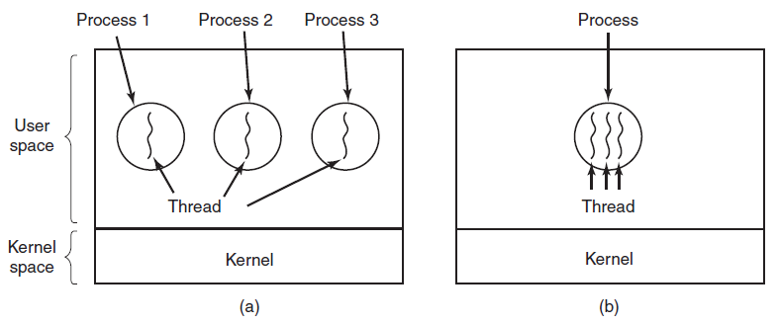
The Classical Thread Model (1)
Figure 2-11. (a) Three processes each with one thread.
(b) One process with three threads.
Tanenbaum & Bo,Modern Operating Systems:4th ed., (c) 2013 Prentice-Hall, Inc. All rights reserved.

Slide 18
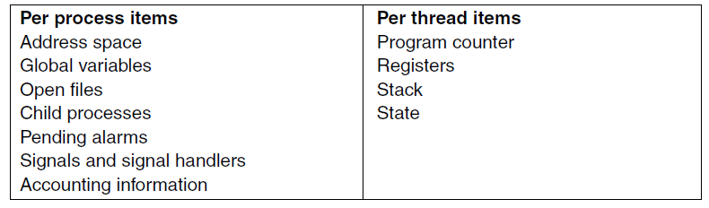
The Classical Thread Model (2)
Figure 2-12. The first column lists some items shared by all threads in a process. The second one lists some items private to each thread.
Tanenbaum & Bo,Modern Operating Systems:4th ed., (c) 2013 Prentice-Hall, Inc. All rights reserved.

Slide 19
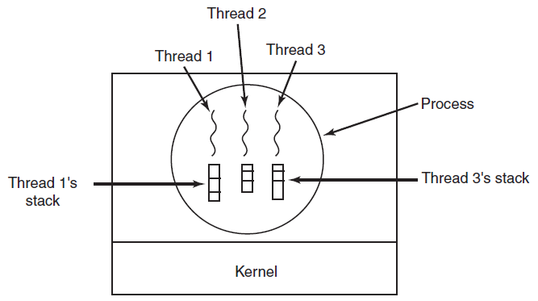
The Classical Thread Model (3)
Figure 2-13. Each thread has its own stack.
Tanenbaum & Bo,Modern Operating Systems:4th ed., (c) 2013 Prentice-Hall, Inc. All rights reserved.

Slide 20
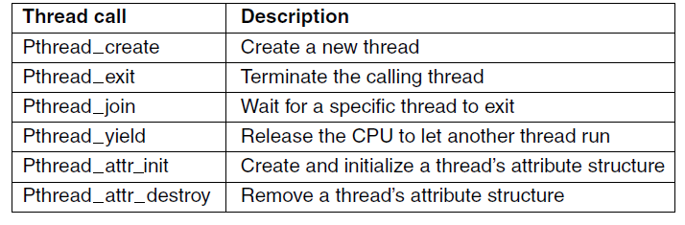
POSIX Threads (1)
Figure 2-14. Some of the Pthreads function calls.
Tanenbaum & Bo,Modern Operating Systems:4th ed., (c) 2013 Prentice-Hall, Inc. All rights reserved.

Slide 21
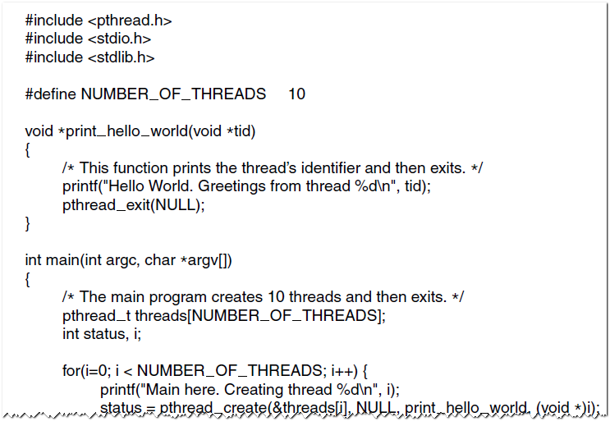
POSIX Threads (2)
Figure 2-15. An example program using threads.
Tanenbaum & Bo,Modern Operating Systems:4th ed., (c) 2013 Prentice-Hall, Inc. All rights reserved.

Slide 22
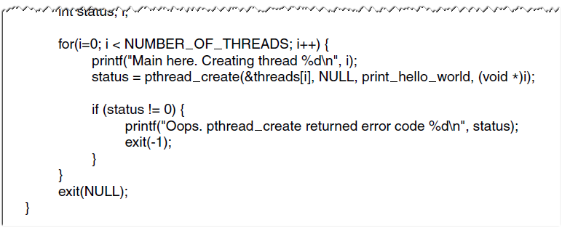
POSIX Threads (3)
Figure 2-15. An example program using threads.
Tanenbaum & Bo,Modern Operating Systems:4th ed., (c) 2013 Prentice-Hall, Inc. All rights reserved.

Slide 23
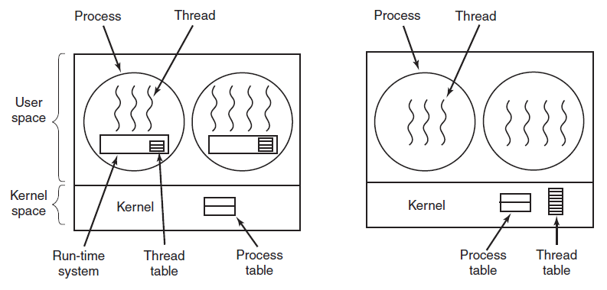
Implementing Threads in User Space
(a)
(b)
Figure 2-16. (a) A user-level threads package.
(b) A threads package managed by the kernel.
Tanenbaum & Bo,Modern Operating Systems:4th ed., (c) 2013 Prentice-Hall, Inc. All rights reserved.

Slide 24
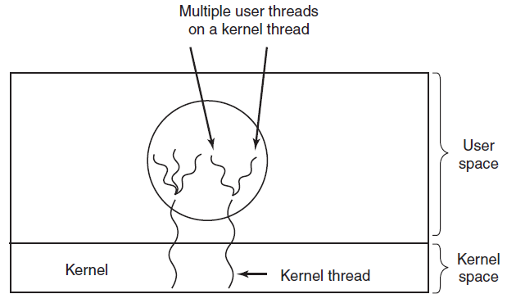
Hybrid Implementations
Figure 2-17. Multiplexing user-level threads
onto kernel-level threads.
Tanenbaum & Bo,Modern Operating Systems:4th ed., (c) 2013 Prentice-Hall, Inc. All rights reserved.

Slide 25
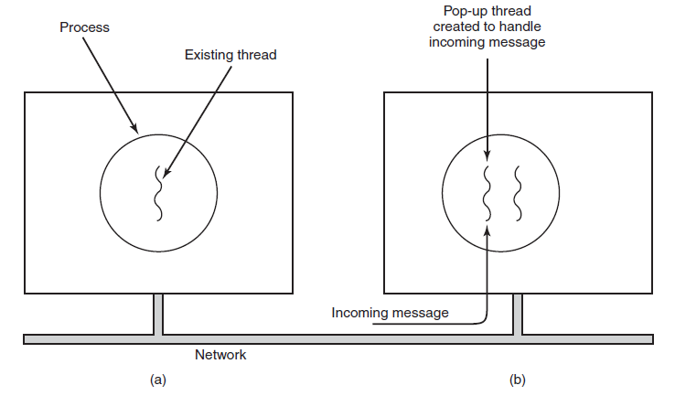
Pop-Up Threads
Figure 2-18. Creation of a new thread when a message arrives. (a) Before the message arrives. (b) After the message arrives.
Tanenbaum & Bo,Modern Operating Systems:4th ed., (c) 2013 Prentice-Hall, Inc. All rights reserved.

Slide 26
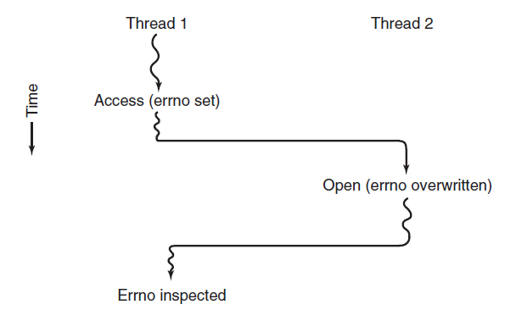
Making Single-Threaded Code Multithreaded (1)
Figure 2-19. Conflicts between threads over the
use of a global variable.
Tanenbaum & Bo,Modern Operating Systems:4th ed., (c) 2013 Prentice-Hall, Inc. All rights reserved.

Slide 27
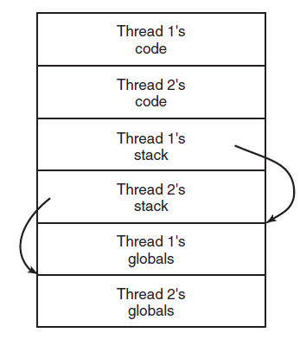
Making Single-Threaded Code Multithreaded (2)
Figure 2-20. Threads can have private global variables.
Tanenbaum & Bo,Modern Operating Systems:4th ed., (c) 2013 Prentice-Hall, Inc. All rights reserved.

Slide 28
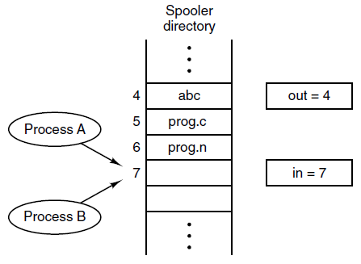
Race Conditions
Figure 2-21. Two processes want to access
shared memory at the same time.
Tanenbaum & Bo,Modern Operating Systems:4th ed., (c) 2013 Prentice-Hall, Inc. All rights reserved.

Slide 29
Critical Regions (1)
Requirements to avoid race conditions:
No two processes may be simultaneously inside their critical regions.
No assumptions may be made about speeds or the number of CPUs.
No process running outside its critical region may block other processes.
No process should have to wait forever to enter its critical region.
Tanenbaum & Bo,Modern Operating Systems:4th ed., (c) 2013 Prentice-Hall, Inc. All rights reserved.

Slide 30
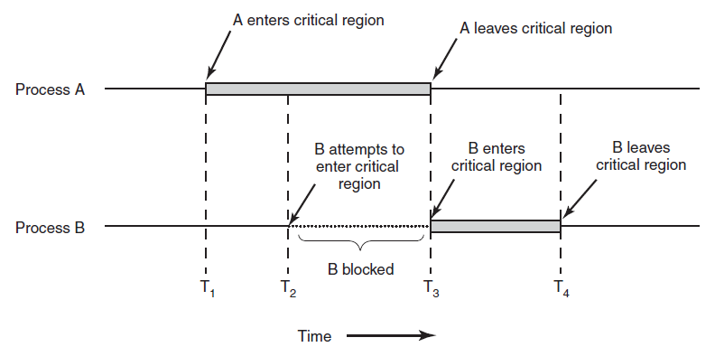
Critical Regions (2)
Figure 2-22. Mutual exclusion using critical regions.
Tanenbaum & Bo,Modern Operating Systems:4th ed., (c) 2013 Prentice-Hall, Inc. All rights reserved.

Slide 31
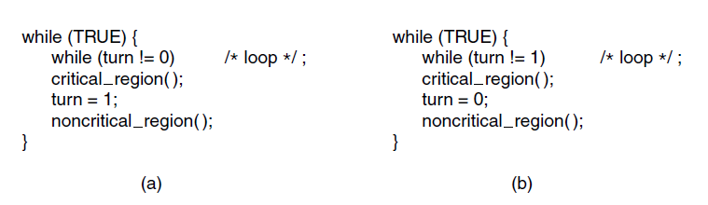
Mutual Exclusion with Busy Waiting:
Strict Alternation
Figure 2-23. A proposed solution to the critical region problem. (a) Process 0. (b) Process 1. In both cases, be sure to note the semicolons terminating the while statements.
Tanenbaum & Bo,Modern Operating Systems:4th ed., (c) 2013 Prentice-Hall, Inc. All rights reserved.

Slide 32
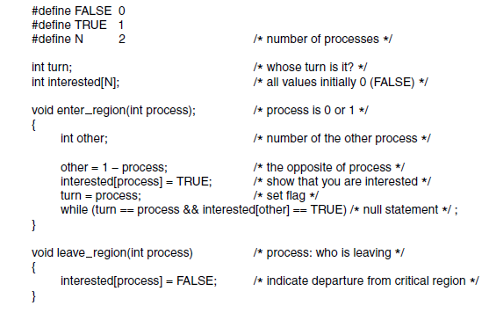
Mutual Exclusion with Busy Waiting:
Peterson’s Solution
Figure 2-24. Peterson’s solution for achieving mutual exclusion.
Tanenbaum & Bo,Modern Operating Systems:4th ed., (c) 2013 Prentice-Hall, Inc. All rights reserved.

Slide 33
Mutual Exclusion with Busy Waiting
VAR A[N]: Boolean;（false)
number[N]: integer; (0)
Pi 进入：
1. A[i]=true;
2. number[i]=max{number[0],…,number[n-1]}+1;
3. A[i]=false;
4. For (j=0 ；j< n ；j++)
5. { While (A[j]) ;
6. While（ (number[j]!=0)＆＆
(number[j],j)<(number[i],i) ） skip；
/＊(a,b)<(c,d) iff (a<c)or(a=c and b<d)＊/

Slide 34
Mutual Exclusion with Busy Waiting
flag[i]=idle: 进程Pi不想进入临界区
flag[i]=want_in: 进程Pi想进入临界区
flag[i]=in_cs: 进程Pi想进入或已进入临界区
Pi进入:
1do {flag[i]=want_in;
2 j=turn;
3 While( j!=i)
4 If (flag[j]!=idle) j=turn;
5 Else j=(j+1)mod n;
6 flag[i]=in_cs;
7 j=0;
8 While (j<n)&&(j==i || flag[j]!=in_cs)
9 j:=j+1;
10 }While((j!=n)|| (turn!=i &&flag[turn]!=idle));
turn:=i;

Slide 35
Mutual Exclusion with Busy Waiting
CS
Pi离开：
j=(turn+1)mod n;
While (flag[j]==idle&&j!=i)
j=(j+1)mod n;
turn=j;
flag[i]=idle;

Slide 36
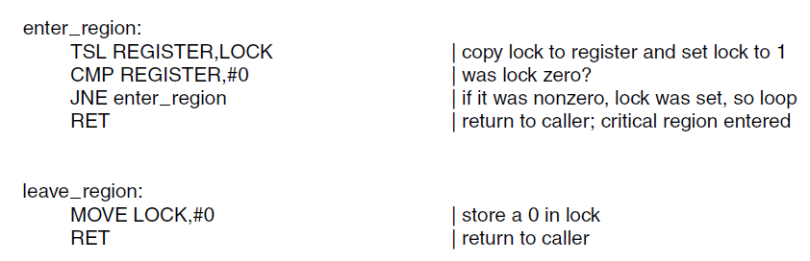
Mutual Exclusion with Busy Waiting:
The TSL Instruction (1)
Figure 2-25. Entering and leaving a critical region
using the TSL instruction.
Tanenbaum & Bo,Modern Operating Systems:4th ed., (c) 2013 Prentice-Hall, Inc. All rights reserved.

Slide 37
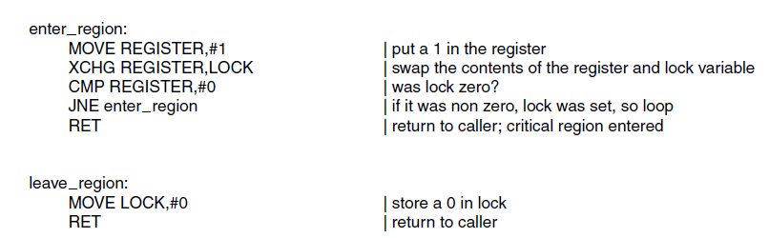
Mutual Exclusion with Busy Waiting:
The TSL Instruction (2)
Figure 2-26. Entering and leaving a critical region
using the XCHG instruction
Tanenbaum & Bo,Modern Operating Systems:4th ed., (c) 2013 Prentice-Hall, Inc. All rights reserved.

Slide 38
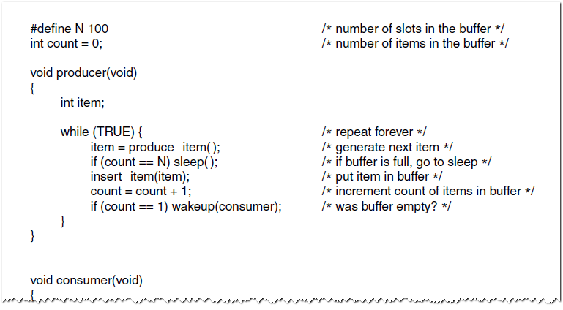
Sleep and Wakeup
The Producer-Consumer Problem (1)
Figure 2-27. The producer-consumer problem
with a fatal race condition.
Tanenbaum & Bo,Modern Operating Systems:4th ed., (c) 2013 Prentice-Hall, Inc. All rights reserved.

Slide 39
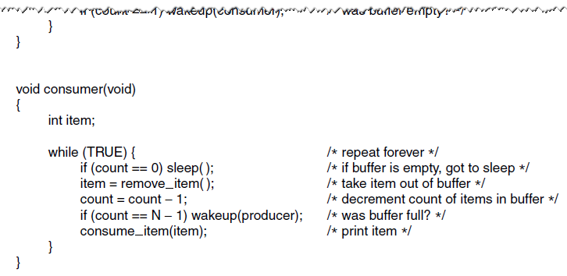
Sleep and Wakeup
The Producer-Consumer Problem (2)
Figure 2-27. The producer-consumer problem
with a fatal race condition.
Tanenbaum & Bo,Modern Operating Systems:4th ed., (c) 2013 Prentice-Hall, Inc. All rights reserved.

Slide 40
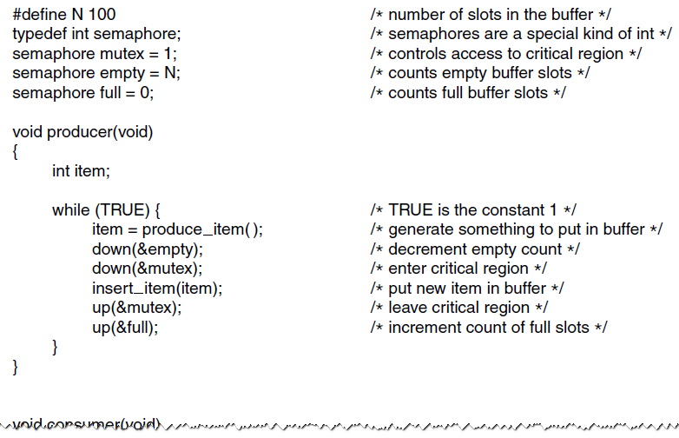
Semaphores (1)
Figure 2-28. The producer-consumer problem
using semaphores.
Tanenbaum & Bo,Modern Operating Systems:4th ed., (c) 2013 Prentice-Hall, Inc. All rights reserved.

Slide 41
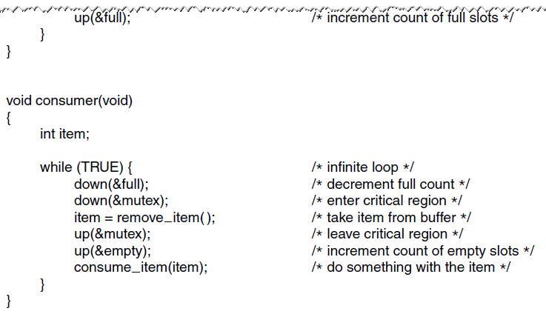
Semaphores (2)
Figure 2-28. The producer-consumer problem
using semaphores.
Tanenbaum & Bo,Modern Operating Systems:4th ed., (c) 2013 Prentice-Hall, Inc. All rights reserved.

Slide 42

Dining Philosophers Problem
Figure 2-44. Lunch time in the Philosophy Department.
Tanenbaum, Modern Operating Systems 3 e, (c) 2008 Prentice-Hall, Inc. All rights reserved. 0-13-6006639

Slide 43
Int a[5]={0},I
Semaphore b[5]={0},s;
procedure test(I)
{if(a[i]==1&&a[(i-1)%5]!=2&& a[(i+1)%5]!=2)
{a[i]=2;v(b[i]);}}
Procedure philosopher(I)
{p(s);
a[i]=1;test[i];
V[s];
P(b[i]);
pick_up_fork(I);pick_up_fork((I+1)mod 5);
{Eating};
put_down_fork(I);put_down_fork((I+1)mod 5);
P(s);
A[i]=0;test((i-1)%5); 0;test((i+1)%5);
V(s);

Slide 44
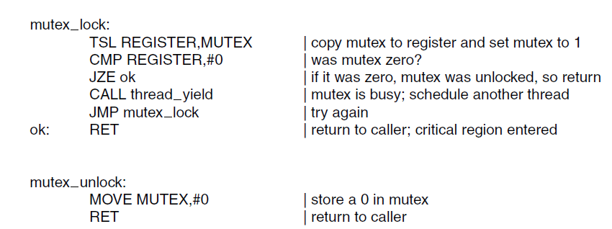
Mutexes
Figure 2-29. Implementation of mutex_lock
and mutex_unlock.
Tanenbaum & Bo,Modern Operating Systems:4th ed., (c) 2013 Prentice-Hall, Inc. All rights reserved.

Slide 45
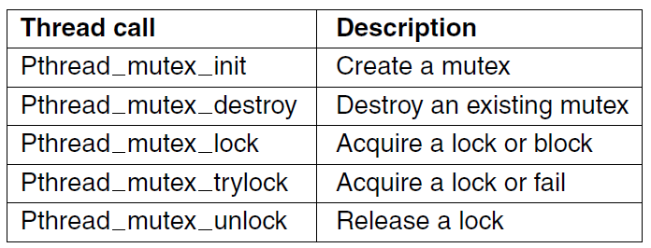
Mutexes in Pthreads (1)
Figure 2-30. Some of the Pthreads calls relating to mutexes.
Tanenbaum & Bo,Modern Operating Systems:4th ed., (c) 2013 Prentice-Hall, Inc. All rights reserved.

Slide 46
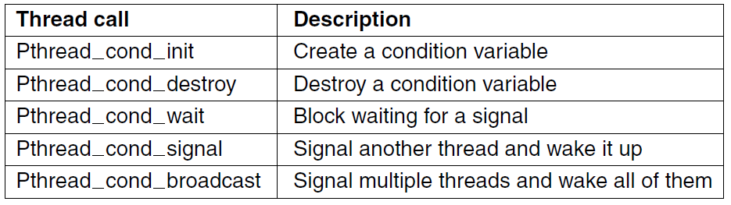
Mutexes in Pthreads (2)
Figure 2-31. Some of the Pthreads calls relating
to condition variables.
Tanenbaum & Bo,Modern Operating Systems:4th ed., (c) 2013 Prentice-Hall, Inc. All rights reserved.

Slide 47
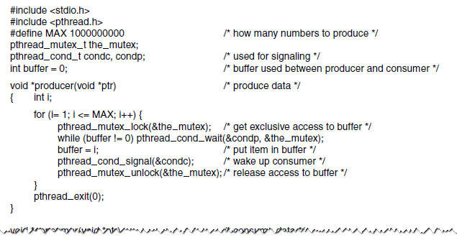
Mutexes in Pthreads (3)
Figure 2-32. Using threads to solve the
producer-consumer problem.
Tanenbaum & Bo,Modern Operating Systems:4th ed., (c) 2013 Prentice-Hall, Inc. All rights reserved.

Slide 48
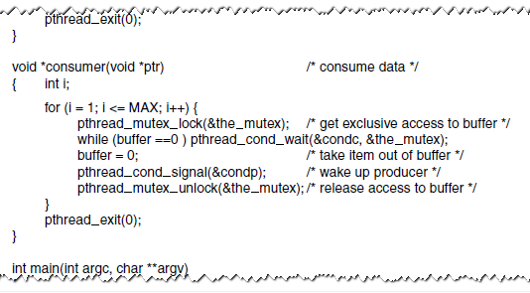
Mutexes in Pthreads (4)
Figure 2-32. Using threads to solve the
producer-consumer problem.
Tanenbaum & Bo,Modern Operating Systems:4th ed., (c) 2013 Prentice-Hall, Inc. All rights reserved.

Slide 49
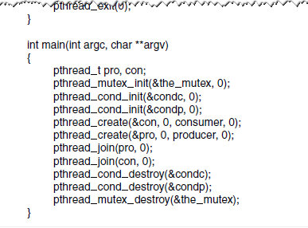
Mutexes in Pthreads (5)
Figure 2-32. Using threads to solve the
producer-consumer problem.
Tanenbaum & Bo,Modern Operating Systems:4th ed., (c) 2013 Prentice-Hall, Inc. All rights reserved.

Slide 50
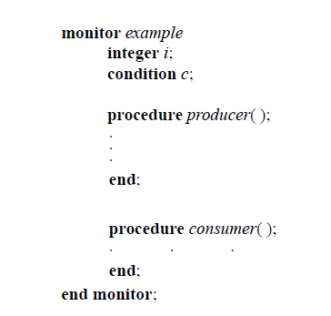
Monitors (1)
Figure 2-33. A monitor.
Tanenbaum & Bo,Modern Operating Systems:4th ed., (c) 2013 Prentice-Hall, Inc. All rights reserved.

Slide 51
管程的共享变量在管程外部不可见，外部只能通过调用管程中的外部子程序访问共享变量；
为保证对共享变量操作的数据完整性，规定管程互斥进入；
管程中有等待/唤醒机制，等待时释放管程的互斥权，唤醒时（P唤醒Q）：
  P等待，Q继续，直到Q退出或等待；(Hoare)
  Q等待，P继续，直到P退出或等待；(Java)
  唤醒是管程中可执行的最后一个操作。（Hansen)

Slide 52
Hoare管程设施
入口等待队列：
  每个管程变量一个，用于排队进入；
紧急等待队列：
  每个管程变量一个，用于唤醒等待；
内部等待队列：
  var c: condition; 可根据需要定义多个，用于设置等待条件。

Slide 53
管程队列
PCB
PCB
…
c1
PCB
PCB
…
入口队列
c2
PCB
PCB
…
PCB
PCB
…
Monitor
紧急队列

Slide 54
进入与离开
进入管程：
  申请管程互斥权。
离开管程：
  如紧急等待队列非空，唤醒第一个等待者；否则开放管程。

Slide 55
条件变量操作
Var c:condition;
wait(c):
  如紧急队列非空，唤醒第一个等待者，否则释放管程互斥权;
  执行此操作的进程（线程）进入c链尾。
signal(c):
  如c链空，相当空操作。
  否则唤醒第一个，执行此操作的进程（线程）进入紧急队列。

Slide 56
例1.生产消费问题
Type producer_consumer = MONITOR
Var B:Array[0..n-1]Of integer;
count, in, out: integer;
pq, cq:condition;
define put_in, get_out;
Procedure put_in(item:integer);
Begin
If(count==n)Then
wait(pq);
B[in]:=item;
in:=(in+1)%n;
count++;
signal(cq);
End;

Slide 57
例1.生产消费问题
Procedure get_out(Var item:integer)
Begin
If(count==0)Then
wait(cq);
item:=B[out];
out:=(out+1)%n;
count--;
signal(pq);
End;
Begin
in:=0; out:=0; count:=0;
End;

Slide 58
例2. 读者/写者问题
写者优先
Type readers_writers = Monitor;
Var rq,wq: condition;
reading_count,write_count:integer;
Define start_read,finish_read,
start_write,finish_write;

Slide 59
例2. 读者/写者问题
Procedure start_read;
Begin
If write_count>0 Then
wait(rq);
reading_count++;
signal(rq);
End;
Procedure finish_read;
Begin
reading_count--;
If reading_count=0
Then signal(wq)
End;

Slide 60
例2. 读者/写者问题
Procedure start_write
Begin
write_count++;
If (write_count>1) or
(reading_count>0)
Then
wait(wq)
End;
Procedure finish_write;
Begin
write_count--;
If write_count>0
Then signal(wq)
Else signal(rq)
End;

Slide 61
例2. 读者/写者问题
Begin
reading_count:=0;
write_count:=0;
End;
Var rw:readers_writers;
读者： 写者：
rw.start_read; rw.start_write;
{reading} {writing}
rw.finish_read; rw.finish_write;
rw:
reading_count
write_count
rq
wq

Slide 62
例3. 哲学家就餐问题
哲学家活动：
Repeat
思考
L: 取左叉
If 右叉空闲 Then
Begin 取右叉，进食，放左叉，放右叉 end;
Else Begin 放左叉, goto L end;
Until false

Slide 63
例3. 哲学家就餐问题
Type dining-philosophers=MONITOR
Var fork:Array[0..4]Of(free,used);
q:Array[0..4]Of condition;
define pick_up, try_pick_up, put_down;
Procedure pick_up(I:0..4);
Begin
If fork[I]=used Then
wait(q[I]);
fork[I]:=used
End;

Slide 64
例3. 哲学家就餐问题
Function try_pick_up(I:0..4):boolean;
Begin
If fork[I]=used Then
try_pick_up:=false
Else Begin
fork[I]:=used;
try_pick_up:=true
End
End;

Slide 65
例3. 哲学家就餐问题
Procedure put_down(I:0..4);
Begin
fork[I]:=free;
signal(q[I])
End;
Procedure init;
Var I:0..4;
Begin
For I:=0 to 4 Do fork[I]:=free;
End;
Begin init End;

Slide 66
例3. 哲学家就餐问题
Var forks:dining_philosophers;
I号哲学家活动：
Repeat
{thinking}
with_two_forks:=false;
Repeat
forks.pick_up(I);
If forks.try_pick_up((I+1)mod 5)Then
with_two_forks:=true
Else forks.put_down(I)
Until with_two_forks;

Slide 67
例3. 哲学家就餐问题
{Eating}
forks.put_down(I);
forks.put_down((I+1)mod 5)
Until false;

Slide 68
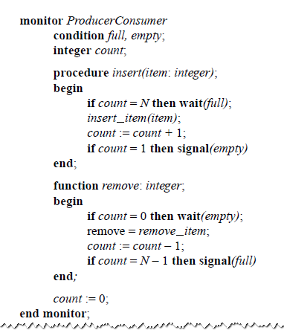
Monitors (2)
Figure 2-34. An outline of the producer-consumer problem with monitors. Only one monitor procedure at a time is active. The buffer has N slots.
Tanenbaum & Bo,Modern Operating Systems:4th ed., (c) 2013 Prentice-Hall, Inc. All rights reserved.

Slide 69
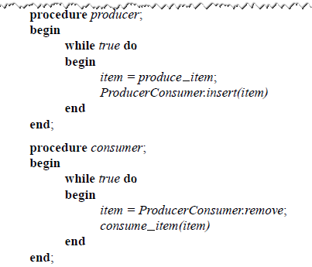
Monitors (3)
Figure 2-34. An outline of the producer-consumer problem with monitors. Only one monitor procedure at a time is active. The buffer has N slots.
Tanenbaum & Bo,Modern Operating Systems:4th ed., (c) 2013 Prentice-Hall, Inc. All rights reserved.

Slide 70
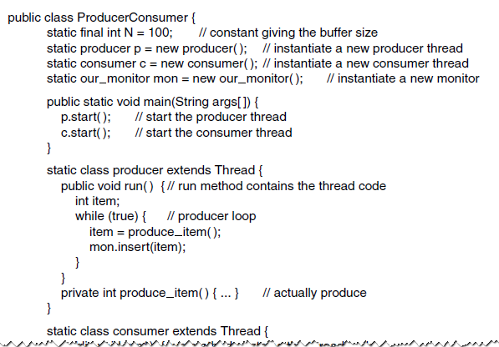
Monitors (4)
Figure 2-35. A solution to the producer-consumer
problem in Java.
Tanenbaum & Bo,Modern Operating Systems:4th ed., (c) 2013 Prentice-Hall, Inc. All rights reserved.

Slide 71
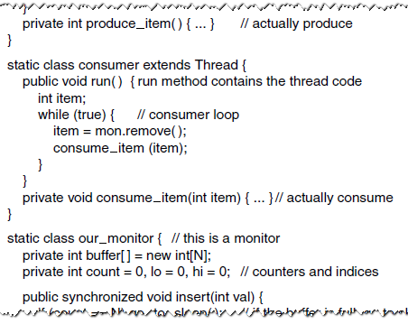
Monitors (5)
Figure 2-35. A solution to the producer-consumer
problem in Java.
Tanenbaum & Bo,Modern Operating Systems:4th ed., (c) 2013 Prentice-Hall, Inc. All rights reserved.

Slide 72
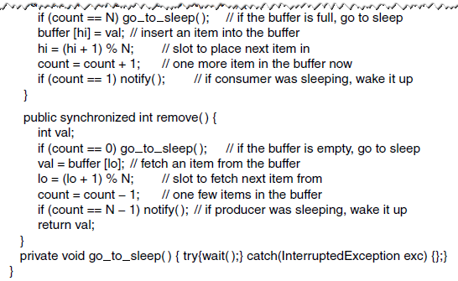
Monitors (6)
Figure 2-35. A solution to the producer-consumer
problem in Java.
Tanenbaum & Bo,Modern Operating Systems:4th ed., (c) 2013 Prentice-Hall, Inc. All rights reserved.

Slide 73
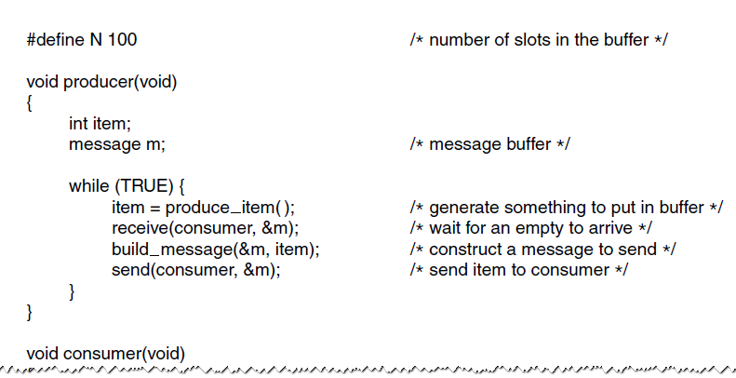
The Producer-Consumer Problem with Message Passing (1)
Figure 2-36. The producer-consumer
problem with N messages.
Tanenbaum & Bo,Modern Operating Systems:4th ed., (c) 2013 Prentice-Hall, Inc. All rights reserved.

Slide 74
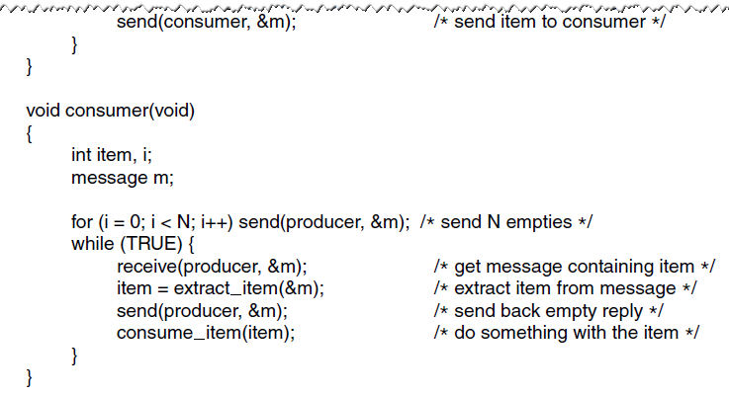
The Producer-Consumer Problem with Message Passing (2)
Figure 2-36. The producer-consumer
problem with N messages.
Tanenbaum & Bo,Modern Operating Systems:4th ed., (c) 2013 Prentice-Hall, Inc. All rights reserved.

Slide 75
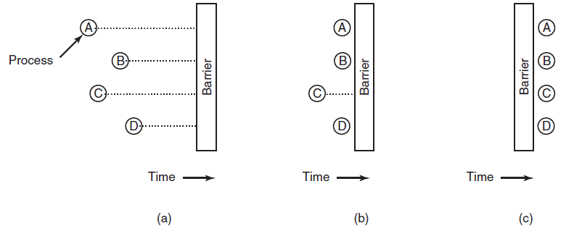
Barriers
Figure 2-37. Use of a barrier. (a) Processes approaching a barrier. (b) All processes but one blocked at the barrier. (c) When the last process arrives at the barrier, all of them are let through.
Tanenbaum & Bo,Modern Operating Systems:4th ed., (c) 2013 Prentice-Hall, Inc. All rights reserved.

Slide 76
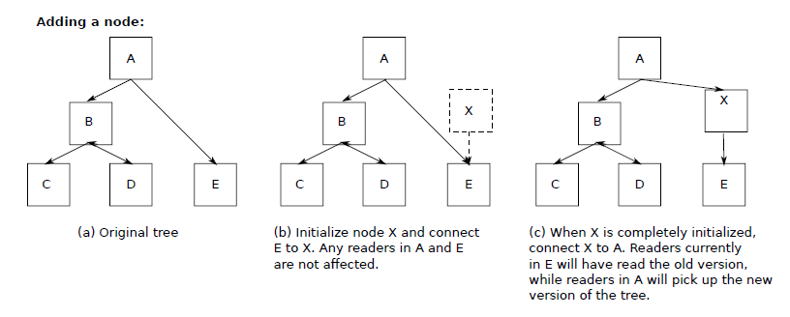
Avoiding Locks: Read-Copy-Update (1)
Figure 2-38. Read-Copy-Update: inserting a node in the tree and then removing a branch—all without locks
Tanenbaum & Bo,Modern Operating Systems:4th ed., (c) 2013 Prentice-Hall, Inc. All rights reserved.

Slide 77
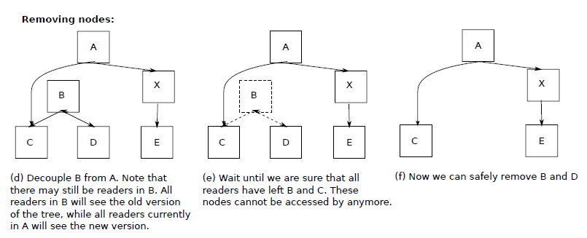
Avoiding Locks: Read-Copy-Update (2)
Figure 2-38. Read-Copy-Update: inserting a node in the tree and then removing a branch—all without locks
Tanenbaum & Bo,Modern Operating Systems:4th ed., (c) 2013 Prentice-Hall, Inc. All rights reserved.

Slide 78

Introduction to Scheduling
Process Behavior
Figure 2-39. Bursts of CPU usage alternate with periods of waiting for I/O. (a) A CPU-bound process. (b) An I/O-bound process.
Tanenbaum & Bo,Modern Operating Systems:4th ed., (c) 2013 Prentice-Hall, Inc. All rights reserved.

Slide 79
Categories of Scheduling Algorithms
Batch.
Interactive.
Real time.
Tanenbaum & Bo,Modern Operating Systems:4th ed., (c) 2013 Prentice-Hall, Inc. All rights reserved.

Slide 80

Scheduling Algorithm Goals
Figure 2-40. Some goals of the scheduling algorithm under different circumstances.
Tanenbaum & Bo,Modern Operating Systems:4th ed., (c) 2013 Prentice-Hall, Inc. All rights reserved.

Slide 81
Scheduling in Batch Systems
First-Come First-Served
Shortest Job First
Shortest Remaining Time Next
Tanenbaum & Bo,Modern Operating Systems:4th ed., (c) 2013 Prentice-Hall, Inc. All rights reserved.

Slide 82

Shortest Job First
Figure 2-41. An example of shortest job first scheduling.
(a) Running four jobs in the original order.
(b) Running them in shortest job first order.
Tanenbaum & Bo,Modern Operating Systems:4th ed., (c) 2013 Prentice-Hall, Inc. All rights reserved.

Slide 83
Scheduling in Interactive Systems
Round-Robin Scheduling
Priority Scheduling
Multiple Queues
Shortest Process Next
Guaranteed Scheduling
Lottery Scheduling
Fair-Share Scheduling
Tanenbaum & Bo,Modern Operating Systems:4th ed., (c) 2013 Prentice-Hall, Inc. All rights reserved.

Slide 84


Round-Robin Scheduling
Figure 2-42. Round-robin scheduling. (a) The list of
runnable processes. (b) The list of runnable
processes after B uses up its quantum.
Tanenbaum & Bo,Modern Operating Systems:4th ed., (c) 2013 Prentice-Hall, Inc. All rights reserved.

Slide 85

Priority Scheduling
Figure 2-43. A scheduling algorithm with four priority classes.
Tanenbaum & Bo,Modern Operating Systems:4th ed., (c) 2013 Prentice-Hall, Inc. All rights reserved.

Slide 86

Scheduling in Real-Time Systems
Time plays an essential role
Categories
  Hard real time
  Soft real time
  Periodic or aperiodic
Schedulable satisfies
Tanenbaum & Bo,Modern Operating Systems:4th ed., (c) 2013 Prentice-Hall, Inc. All rights reserved.

Slide 87

Thread Scheduling (1)
Figure 2-44. (a) Possible scheduling of user-level threads with a 50-msec process quantum and threads that run 5 msec per CPU burst.
Tanenbaum & Bo,Modern Operating Systems:4th ed., (c) 2013 Prentice-Hall, Inc. All rights reserved.

Slide 88

Thread Scheduling (2)
Figure 2-44. (b) Possible scheduling of kernel-level threads
with the same characteristics as (a).
Tanenbaum & Bo,Modern Operating Systems:4th ed., (c) 2013 Prentice-Hall, Inc. All rights reserved.

Slide 89

The Dining Philosophers Problem (1)
Figure 2-45. Lunch time in the Philosophy Department.
Tanenbaum & Bo,Modern Operating Systems:4th ed., (c) 2013 Prentice-Hall, Inc. All rights reserved.

Slide 90

The Dining Philosophers Problem (2)
Figure 2-46. A nonsolution to the dining philosophers problem.
Tanenbaum & Bo,Modern Operating Systems:4th ed., (c) 2013 Prentice-Hall, Inc. All rights reserved.

Slide 91

The Dining Philosophers Problem (3)
Figure 2-47. A solution to the dining philosophers problem.
Tanenbaum & Bo,Modern Operating Systems:4th ed., (c) 2013 Prentice-Hall, Inc. All rights reserved.

Slide 92

The Dining Philosophers Problem (4)
Figure 2-47. A solution to the dining philosophers problem.
Tanenbaum & Bo,Modern Operating Systems:4th ed., (c) 2013 Prentice-Hall, Inc. All rights reserved.

Slide 93

The Dining Philosophers Problem (5)
Figure 2-47. A solution to the dining philosophers problem.
Tanenbaum & Bo,Modern Operating Systems:4th ed., (c) 2013 Prentice-Hall, Inc. All rights reserved.

Slide 94

The Readers and Writers Problem (1)
Figure 2-48. A solution to the readers and writers problem.
Tanenbaum & Bo,Modern Operating Systems:4th ed., (c) 2013 Prentice-Hall, Inc. All rights reserved.

Slide 95

The Readers and Writers Problem (2)
Figure 2-48. A solution to the readers and writers problem.
Tanenbaum & Bo,Modern Operating Systems:4th ed., (c) 2013 Prentice-Hall, Inc. All rights reserved.

Slide 96
End
Chapter 2
Tanenbaum & Bo,Modern Operating Systems:4th ed., (c) 2013 Prentice-Hall, Inc. All rights reserved.

